Slide 1
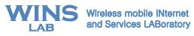
OEFMON: An Open Evaluation Framework for Multimedia Over Networks IEEE Communications Magazine, Sep. 2011
2010.11.
Chunho Lee, Myungchul Kim, Ben Lee,
Soon J. Hyun, Kyounghee Lee, Sooyong Lee

Slide 2
Contents
Introduction
Related work
OEFMON: An Open Evaluation Framework for Multimedia Over Networks
Case studies
Conclusions
References
Notes:
This talk is about a framework for evaluating video transmissions over wireless networks, There are many researches on video transmission over wireless networks However, those researches has a common difficulty. That is there is not enough video transmission tools for those researches.
I’ll begin by explaining what kinds of researches on video transmission over wireless network and existing frameworks for video transmission so far. then, I will explain the proposed framework for evaluating video transmission over wireless network and show how it effectively supports video and network technologies.

Slide 3
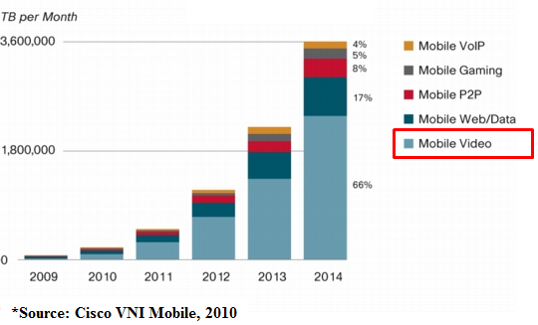
Introduction (1/3)
Introduction
Related work
OEFMON
Case studies
Conclusions
Multimedia devices have become widespread
Smartphones, Portable media player and Tablet computers
The demand for multimedia services has increased
Video traffic will account for 66 percent of global mobile data traffic by 2014*
Notes:
It is not suprising at all to see many people having smartphone or tablet pc
A framework for evaluating video transmissions over a network simulator is needed for following reasons
through network simulator, inexpensive, flexible and reconfigurable network topologies can be set and many researches on network uses network simulator since abnormal network phenomena can be reproduced and can be fixed.
it is needed for simulating various networked video researches over wireless network. There are many networked video researches.
First one is prioritized video transmission, which gives more priority to transmit video traffics
Second one is rate adaptive video transmission which is a mechanism to send video tranffic as the network can send as possible
Last one is error resilience tools which makes video tranffic more roburst even there are some errors on network
I will talk about those technologies in background section

Slide 4
Introduction
Related work
OEFMON
Case studies
Conclusions
Introduction (2/3)
However, multimedia transmissions are challenging
Strict real-time requirements
Packet losses
Evaluations on new mechanism of multimedia transmissions are often conducted with network performance metric
However, those evaluation methods neglect user-perceived quality
Notes:
A framework for evaluating video transmissions over a network simulator is needed for following reasons
through network simulator, inexpensive, flexible and reconfigurable network topologies can be set and many researches on network uses network simulator since abnormal network phenomena can be reproduced and can be fixed.
it is needed for simulating various networked video researches over wireless network. There are many networked video researches.
First one is prioritized video transmission, which gives more priority to transmit video traffics
Second one is rate adaptive video transmission which is a mechanism to send video tranffic as the network can send as possible
Last one is error resilience tools which makes video tranffic more roburst even there are some errors on network
I will talk about those technologies in background section

Slide 5
Introduction
Related work
OEFMON
Case studies
Conclusions
Introduction (3/3)
A framework for evaluating video transmissions over a network simulator is needed for
Inexpensive, flexible and reconfigurable network topologies
Abnormal network phenomena can be reproduced and be fixed
Simulating various networked video research over networks
Rate adaptive video transmission [1]
Prioritized video transmission
Error resilient tools (Data partitioning [2])
Problems in existing evaluation framework such as Evalvid [3] and Evalvid-RA [4] for multimedia over networks
Limited choice of video codec
Lack of multimedia coding support with network feedback

Slide 6
Related work (1/4)
Introduction
Related work
OEFMON
Case studies
Conclusions
Rate adaptive video transmission [1]
The quality of video transmission will degrade when the required bit-rate is higher than the available bandwidth
Rate adaptive video transmission adjusts video bit-rate depending on the current network situation
There is a trade-off between distortion and bit-rate
Adjusting video bit-rate can be achieved with Quantization Parameter (QP)
Distortion ↑ and bit-rate ↓ with higher QP
The structure of rate adaptive video transmission
Notes:
There are two widely used frameworks one is evalvid and another is evalvid-ra
Evavid

Slide 7
Related work (2/4)
Introduction
Related work
OEFMON
Case studies
Conclusions
Data partitioned H.264 video transmission [2]
Prioritized video transmission
H.264/AVC provides error resilience tools including data partitioning feature
Data partitioning allows a coded picture to be separated into up to three data partitions (data partitions A, B and C) in accordance to their importance
Data partition A contains slice header information which is the most important
Data partition B includes intra-slice macro blocks which is the second most important
Data partition C contains inter-coded macro blocks which is the least important
The concept of data partitioned H.264/AVC video transmission (Fig. 2)
Partition A
Reliable Channel
H.264
Encoder
Mid-reliable Channel
H.264
Decoder
partition B
Unreliable Channel
Partition C
Fig. 2. The concept of Data partitioned H.264 video transmission
Notes:
There are two widely used frameworks one is evalvid and another is evalvid-ra
Evavid

Slide 8
Related work (3/4)
Introduction
Related work
OEFMON
Case studies
Conclusions
Multimedia framework
is designed to handle multimedia
provides a common interface for integrating various codecs
facilitate the use of a number of multimedia codecs
Examples are DirectShow [5] in Microsoft windows and Gstreamer [6] in Linux
DirectShow
support a number of video codecs including VP 8 [7] and VC-1 [8]
is a flexible architecture based on Component Object Model
separates multimedia work into multiple processing units and processes the work as a flow
consists of a filter which represent a one stage of processing multimedia data and filter graph which represents a multimedia data flow

Slide 9
Related work (4/4)
Introduction
Related work
OEFMON
Case studies
Conclusions
Evalvid [4]
Trace file based approach
supports only MPEG-4, H.263 and H.264 codecs
Network status cannot be adapted into video coding
Evalvid-RA [5]
An enhanced version of Evalvid to support video rate control
Codec is limited to only MPEG-4
producing trace files for a video with all possible QP before simulation
Range of QP in MPEG-4 is 1 to 41
42 encoded files are required before a simulation
Supports only Group Of Pictures (GOP) level rate control
Notes:
There are two widely used frameworks one is evalvid and another is evalvid-ra
Evavid

Slide 10
OEFMON (1/8)
Introduction
Related work
OEFMON
Case studies
Conclusions
OEFMON: An Open Evaluation Framework for Multimedia over Networks
The two major components are Multimedia Module and Network Simulator
Combining two modules are based on Inter-Process Communication (IPC)
Multimedia Module
is implemented using DirectShow
consists of Video Encoder Filter, Video Decoder Filter and OEFMON Filters
Network Simulator
Modified QualNet [9] for being integrated with OEFMON is used as Network Simulator
consists of Sender and Receiver Agents
Notes:
Here is a concept of our proposed work video source

Slide 11
OEFMON (2/8)
Introduction
Related work
OEFMON
Case studies
Conclusions
The conceptual diagram
Fig. 3. The conceptual diagram
Notes:
Here is a concept of our proposed work video source
During simulation, a sender in the Network Simulator receives coded data from a multimedia encoder in the Multimedia Module and then generates and sends packets to a receiver in accordance with the QoS mapping information

Slide 12
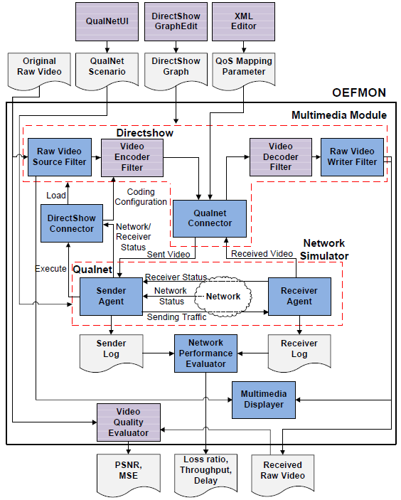
OEFMON (3/8)
Introduction
Related work
OEFMON
Case studies
Conclusions
The structural diagram
Fig. 4. The structural diagram
Notes:
Green box represents 3rd party modules
Red boxes represents modified modules
Other boxes are implemented modules

Slide 13
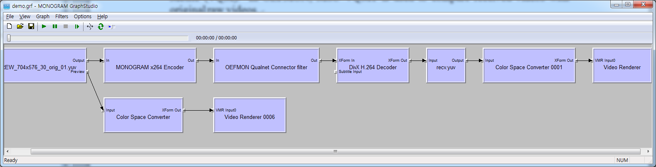
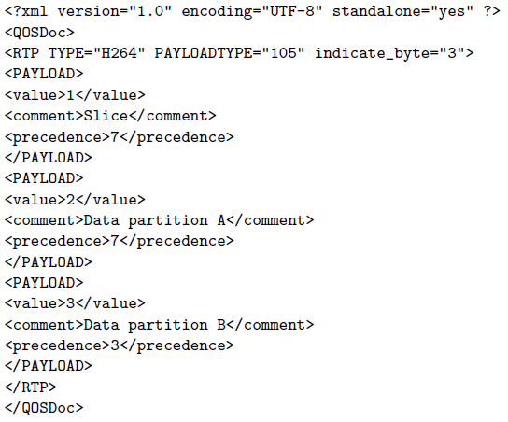
OEFMON (4/8)
Introduction
Related work
OEFMON
Case studies
Conclusions
Framework inputs
Original Raw Video file in YUV format
DirectShow Graph File
is generated using DirectShow GraphEdit which is a utility program for visually building and simulating filter graphs in DirectShow (Fig. 5)
QoS Mapping Parameter
specify the rules for mapping multimedia units into network priorities (Fig. 6)
Fig. 5. An example of DirectShow Graph File
Fig. 6. An example of QoS Mapping Parameter
13
Notes:
I previously showed you that…
I will shortly demonstrate that… but I must explain …

Slide 14
OEFMON (5/8)
Introduction
Related work
OEFMON
Case studies
Conclusions
Components
QualNetUI
provides a configurable user interface for building network topologies and scenarios
DirectShow Connector
is to load DirectShow and then build filter graphs using DirectShow Graph files
Adapt video coding configuration such as video rate obtained from network/receiver status into video encoder by using the interface of Component Object Model
Sender and Receiver Agents
are responsible for sending and receiving RTP packets
Network Performance Evaluator
generates network metrics such as loss ratio and delay
Video Quality Evaluator
Retrieves video quality metrics such as PSNR and MSE
Notes:
I previously showed you that…
I will shortly demonstrate that… but I must explain …

Slide 15
OEFMON (6/8)
Introduction
Related work
OEFMON
Case studies
Conclusions
Components (Cont.)
QualNet Connector Filter
is to integrate the Multimedia Module and the Network Simulator
is designed to be able to connect any filter in DirectShow
Receives coded data from encoders then packetizes them in RTP format and sends them to QualNet with QoS parameter
consists of three internal modules
Packet manager packetizes/depacketizes media stream to/from RTP stream
Jitter manager collects packets from the Receiver Agent in QualNet then, composes the packets into multimedia stream and sends them to Video Decoder filter in DirectShow
IPC Manager provides a tight coupling between QualNet and DirectShow
Notes:
I previously showed you that…
I will shortly demonstrate that… but I must explain …

Slide 16
OEFMON (7/8)
Introduction
Related work
OEFMON
Case studies
Conclusions
Design and implementation issues
Handling time synchronization
Sender Agent in QualNet is continuously suspended until the next coded data is received from QualNet Connector by using blocking I/O operation in Named PIPE
Play-out buffer
Most of the existing mechanisms use either fixed-size or adaptive-size buffer
OEFMON supports fixed-sized buffer
Handling missing frames
Some video frames may not be available for decoding due to error
Missing frames should be compensated with pre-decoded frames for full-reference video quality measurement
Raw Video Writer Filter looks at each media sample, which is a basic processing unit in DirectShow, and checks its timestamp to determine compensation of lost frame
Notes:
I previously showed you that…
I will shortly demonstrate that… but I must explain …

Slide 17
OEFMON (8/8)
Introduction
Related work
OEFMON
Case studies
Conclusions
Supported functionalities
Rate adaptive video transmissions
Through Qualnet Connector filter, video encoder and Qualnet exchange coded data and network feedbacks in a real-time manner
No limitation of codec choice
Qualnet Connector Filter can connect any of filters in DirectShow
H.264, VC-1, ON-2, MPEG-1, MPEG-2, MPEG-4, ….
Prioritized transmission
Qualnet Connector Filter sends RTP packet with QoS parameter
Extensibility
OEFMON is based on a flexible modular structure
Some parts such as network Performance Evaluator, Video Quality Evaluator are easily replaceable
Notes:
I previously showed you that…
I will shortly demonstrate that… but I must explain …

Slide 18
Case studies - Rate adaptive H.264 video transmission over IEEE 802.11a (1/5)
Introduction
Related work
OEFMON
Case studies
Conclusions
Case study: Rate adaptive H.264 video transmission over IEEE 802.11a
is to show the effectiveness of network feedback based video coding with OEFMON
Wireless Bandwidth estimation tool (WBest) [8] which is a bandwidth estimation tool for wireless environment is used to measure available bandwidth

Slide 19
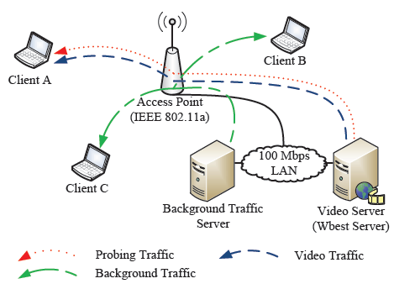
Case studies - Rate adaptive H.264 video transmission over IEEE 802.11a (2/5)
Introduction
Related work
OEFMON
Case studies
Conclusions
Simulation environment
OEFMON adjusts video bit-rate based on available bandwidth estimated by WBest
simulated network topology
1 access point, 3 stations, background Traffic, Wbest and Video Server (Fig. 7)
6 Mbps channel capacity
MONOGRAM x264 encoder [9] and a video clip Crew that consists of 300 frames in 4CIF are used
Fig. 7. Network topology and traffics

Slide 20
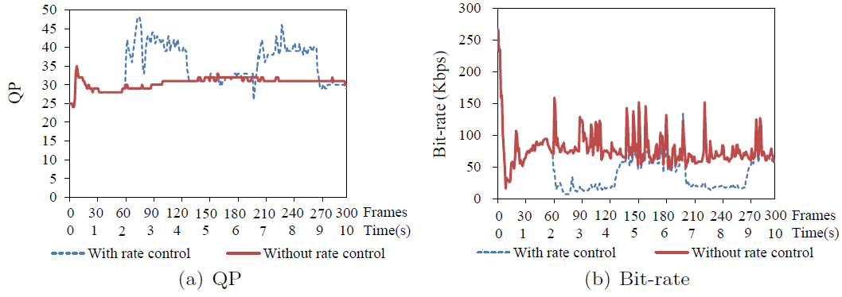
Case studies - Rate adaptive H.264 video transmission over IEEE 802.11a (3/5)
Introduction
Related work
OEFMON
Case studies
Conclusions
Results analysis
QP increases and bit-rate decreases for the rate control scheme as background traffic increases
QP is increased
bit rate is decreased

Slide 21
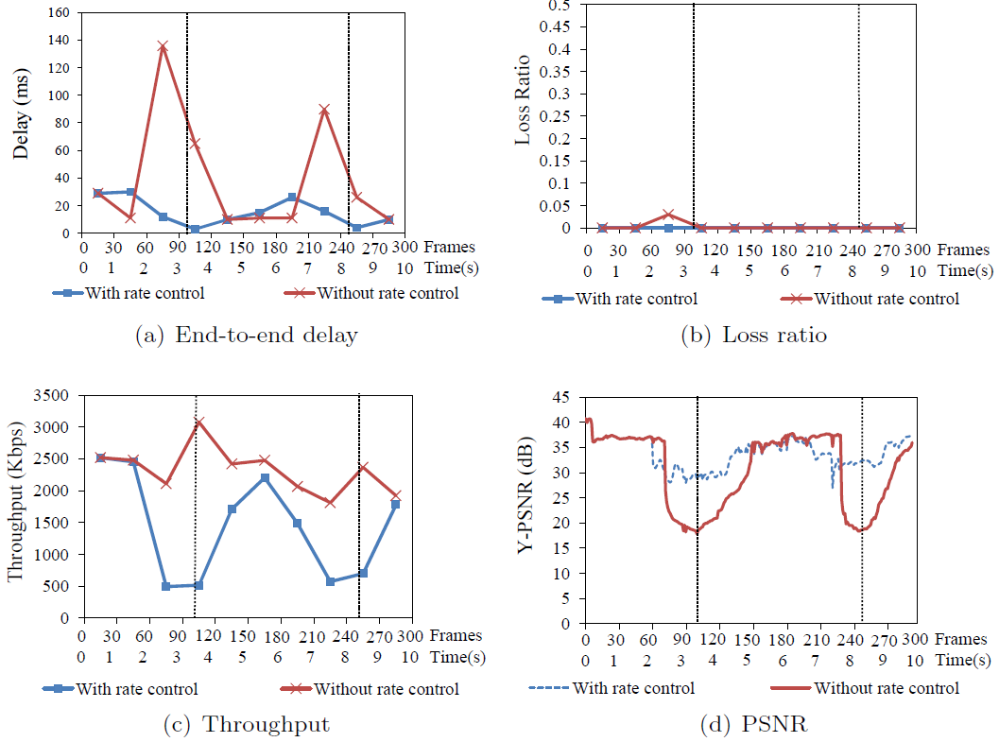
Case studies - Rate adaptive H.264 video transmission over IEEE 802.11a (4/5)
Introduction
Related work
OEFMON
Case studies
Conclusions
Results analysis (Cont.)

Slide 22
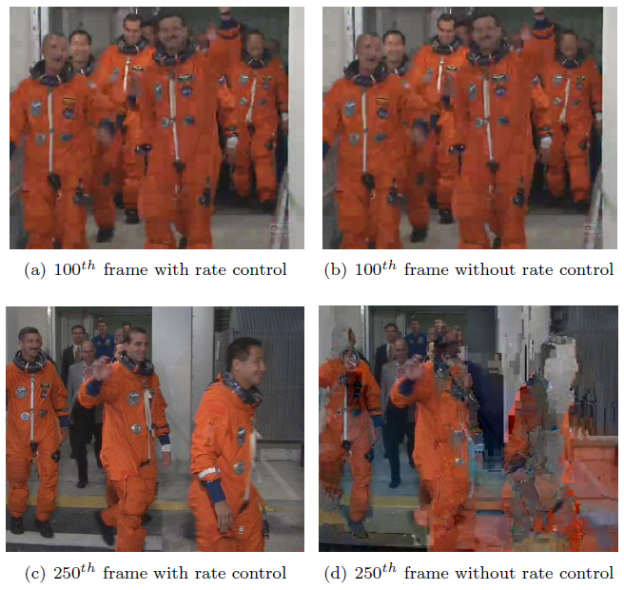
Case studies - Rate adaptive H.264 video transmission over IEEE 802.11a (5/5)
Introduction
Related work
OEFMON
Case studies
Conclusions
Simulation results (Cont.)

Slide 23
Case studies - Data partitioned H.264 video transmission over IEEE 802.11e (1/5)
Introduction
Related work
OEFMON
Case studies
Conclusions
Case study: Data partitioned H.264 video transmission
This case study demonstrates a simulation of cross-layer design for H.264/AVC data partitioned video transmission in IEEE 802.11e with OEFMON
Data partitioning feature in H.264/AVC
QoS Support in IEEE 802.11e Enhanced Distributed Channel Access (EDCA)
A cross-layer architecture based on a QoS mapping scheme for data partitioning and EDCA was proposed in [10]

Slide 24
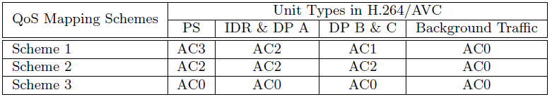
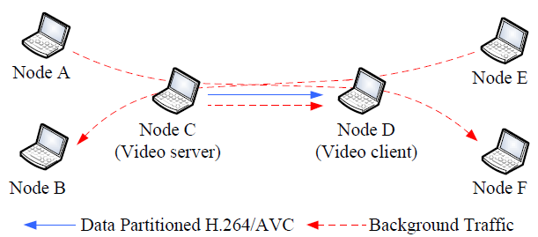
Case studies - Data partitioned H.264 video transmission over IEEE 802.11e (2/5)
Introduction
Related work
OEFMON
Case studies
Conclusions
Simulation environment
Three QoS mapping schemes
simulated network topology
ad hoc network consisting of 6 nodes equipped with IEEE 802.11a (Fig. 6.)
6 Mbps Channel capacity
300 frames of CIF Foreman clip encoded as data partitioned H.264/AVC
Fig. 6. Network topology and traffics

Slide 25
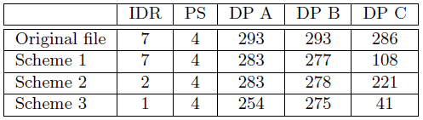
Case studies - Data partitioned H.264 video transmission over IEEE 802.11e (3/5)
Introduction
Related work
OEFMON
Case studies
Conclusions
Results analysis
Number of received IDR slices, parameter set and data partitions (DPs)

Slide 26
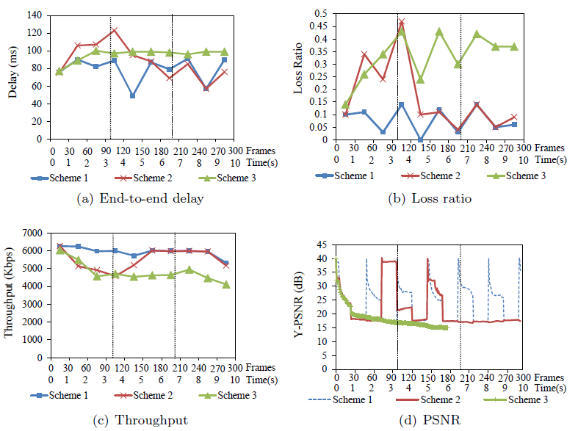
Case studies - Data partitioned H.264 video transmission over IEEE 802.11e (4/5)
Introduction
Related work
OEFMON
Case studies
Conclusions
Results analysis (cont.)

Slide 27
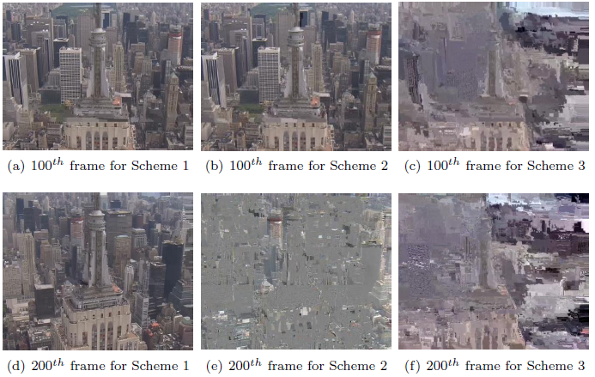
Case studies - Data partitioned H.264 video transmission over IEEE 802.11e (5/5)
Introduction
Related work
OEFMON
Case studies
Conclusions
Results analysis (cont.)

Slide 28
Case studies - VC-1 video transmission over IEEE 802.11 based networks
Introduction
Related work
OEFMON
Case studies
Conclusions
VC-1 video transmission over IEEE 802.11 based networks
This study shows how easily OEFMON supports the implementation of new codecs
IEEE 802.11 based networks configured for Wireless Local Area Networks, Mobile Ad hoc Networks and Wireless mesh networks (WMNs) have drawn a lot of attention to provide Internet access
the performance of those networks suffers from carrier sense interference and the hidden node problem
Carrier sense interference occurs when a node cannot transmit due to another node's transmission, where the two nodes are within the carrier sense range of each other
The hidden node problem occurs when two nodes that are beyond each other's carrier sense range try to send packets

Slide 29
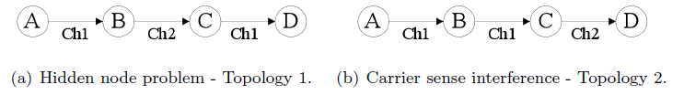
Case studies - VC-1 video transmission over IEEE 802.11 based networks
Introduction
Related work
OEFMON
Case studies
Conclusions
Simulation environment
We compare video transmissions on Topologies 1 and 2 shown by evaluating the performance in terms of user-perceived quality and network performance metrics
simulated network topology
IEEE 802.11a radios with data rate of 18 Mbps
FFdshow encoder is used as a VC-1 encoder to process 300 frames of CIF Foreman clip

Slide 30
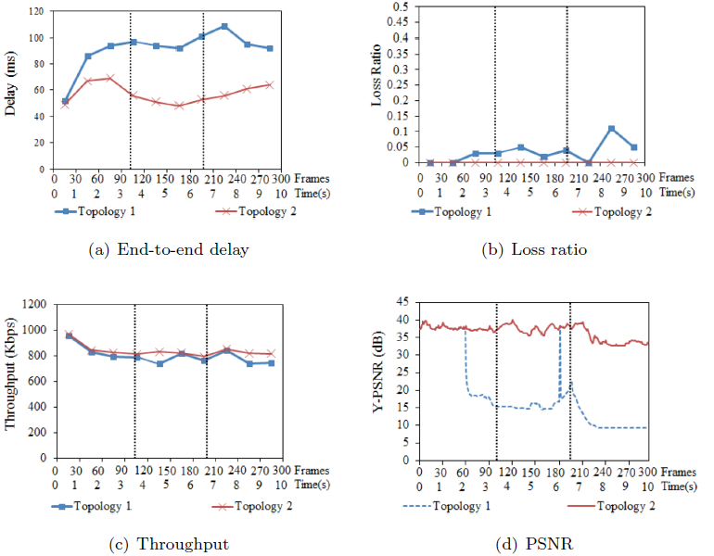
Case studies - VC-1 video transmission over IEEE 802.11 based networks
Introduction
Related work
OEFMON
Case studies
Conclusions
Results analysis

Slide 31
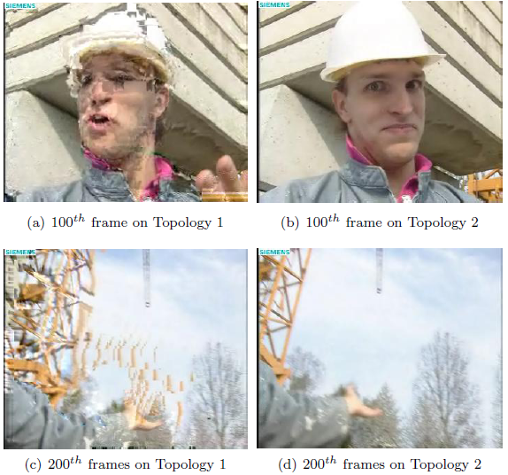
Case studies - VC-1 video transmission over IEEE 802.11 based networks
Introduction
Related work
OEFMON
Case studies
Conclusions
Results analysis

Slide 32
Conclusions
Introduction
Related work
OEFMON
Case studies
Conclusions
OEFMON is
for researchers to evaluate their new mechanism for multimedia over networks
for assessing both measurable and perceptual quality of multimedia transmission resolving limitations that existing work have
OEFMON have advantages
support of various codecs
adaptation of network feedback to multimedia framework in real-time
observation of transmitted video, network performance, and video quality metric
easy extensibility to add new features due to its modularized structure
Future work
OEFMON is planned to extend OEFMON to support Multiview Video Coding and Scalable Video Coding
Notes:
As video streaming is getting popular and widely used, lots of studies have been published for better video transmission over network, Rate adaptive video transmission is adjusting video coding rate to network bandwidth. Scalable Video Coding makes it possible to have temporal spatial scalability and Intra refresh changes Intra frame period Error resilience tools is to resist network error
However there is no tools for simulation to support those idea

Slide 33
References
[1] Chen, M. and Zakhor, A., “Rate control for streaming video over wireless,” IEEE Wireless communication, vol. 12, no. 4, pp. 32-41, 2005.
[2] Wenger, S., “H.264/AVC over IP,” Circuits and Systems for Video Technology, IEEE Transactions on, vol. 13, no. 7, pp. 645-656, 2003.
[3] J. Klaue, B. Tathke, and A. Wolisz, “Evalvid – A framework for video transmission and quality evaluation”, In the 13th International Conference on Modeling Techniques and Tools for Computer Performance Evaluation, pp. 255-272, 2003.
[4] Lie A., Klaue J., “Evalvid-RA: Trace Driven Simulation of Rate Adaptive MPEG-4 VBR Video,” ACM/Springer Multimedia Systems, 2007.
[5] M. Pesce, “Programming Microsoft DirectShow for digital video and television,” Microsoft Press, 2003.
[6] Gstreamer, http://www.gstreamer.net
[7] WebM project, http://www.webmproject.org
[8] Kalva, H. and Lee, J.-B., “The VC-1 video coding standard,”. Multimedia, IEEE vol. 14, no. 4, pp. 88-91, 2007
[9] QualNet Simulator, Scalable Network Technologies. Inc., http:// www.scalable-networks.com
[10] MONOGRAM X264 encoder, http://blog.monogram.sk/janos/2008/11/27/monogram-x264-encoder- 1010/
[11] A. Ksentini, M. Naimi, and A. Gueroui, “Toward an improvement of H. 264 video transmission over IEEE 802.11e through a cross-layer architecture,” IEEE Comm. Magazine, vol. 44, no. 1, pp. 107-114, 2006.
Notes:
As video streaming is getting popular and widely used, lots of studies have been published for better video transmission over network, Rate adaptive video transmission is adjusting video coding rate to network bandwidth. Scalable Video Coding makes it possible to have temporal spatial scalability and Intra refresh changes Intra frame period Error resilience tools is to resist network error
However there is no tools for simulation to support those idea

Slide 34
Questions
Notes:
As video streaming is getting popular and widely used, lots of studies have been published for better video transmission over network, Rate adaptive video transmission is adjusting video coding rate to network bandwidth. Scalable Video Coding makes it possible to have temporal spatial scalability and Intra refresh changes Intra frame period Error resilience tools is to resist network error
However there is no tools for simulation to support those idea

